Slide 1
The Ecology of the Thymus
Mary Browning
3/17/2015

Slide 2
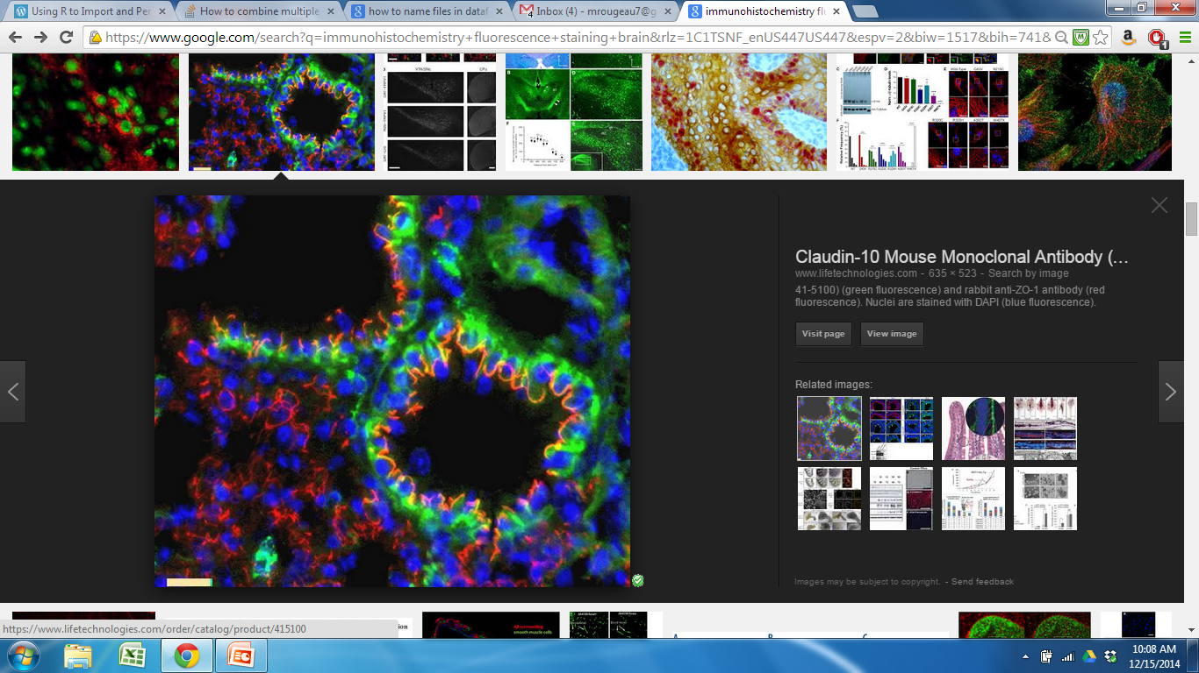
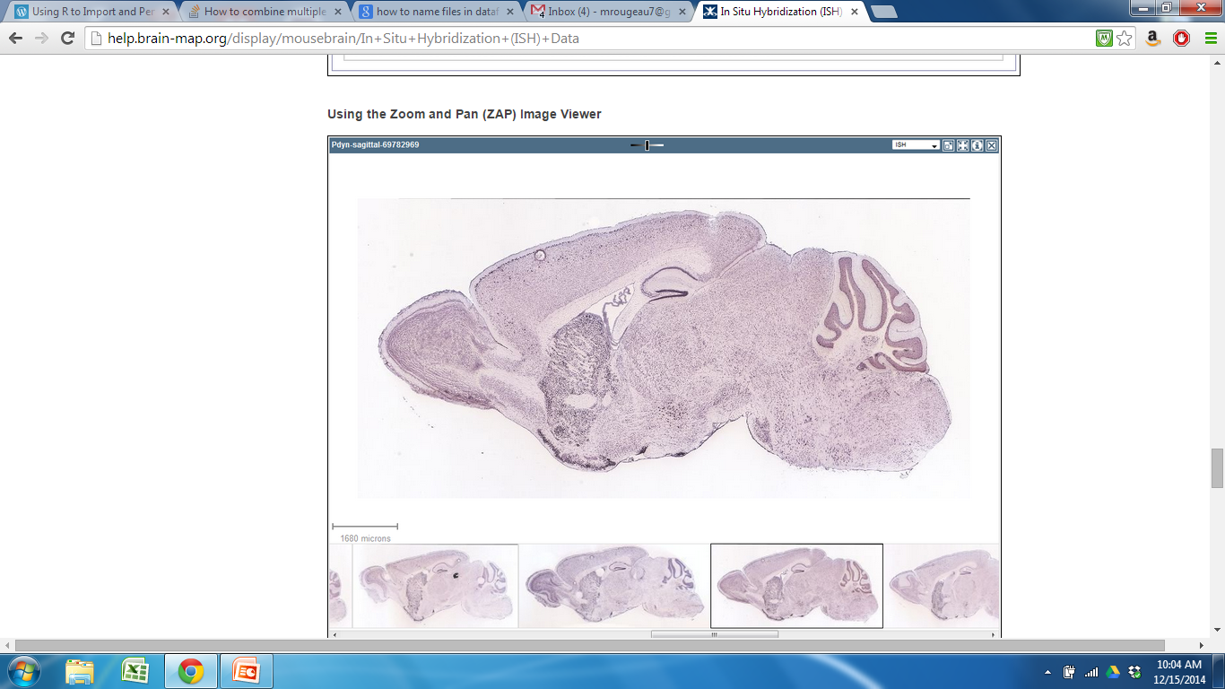
Organization of Organs
Notes:
My project was developed in order to create a method that would allow us to quantitatively look at organization, as opposed to composition, of cell types within biological organs.
beyond essentially descriptive assays (IHC and histological) available in the field of organ biology, there are few statistical tools available for identifying and interpreting organizational characteristics
Organs that would be especially useful for include: Target organs:
endodermal glandular organs (thymus, liver, pancreas) structure is more difficult to perceive, with organizational structures that are visible only with the use of molecular or cellular markers
Function depends on organization

Slide 3

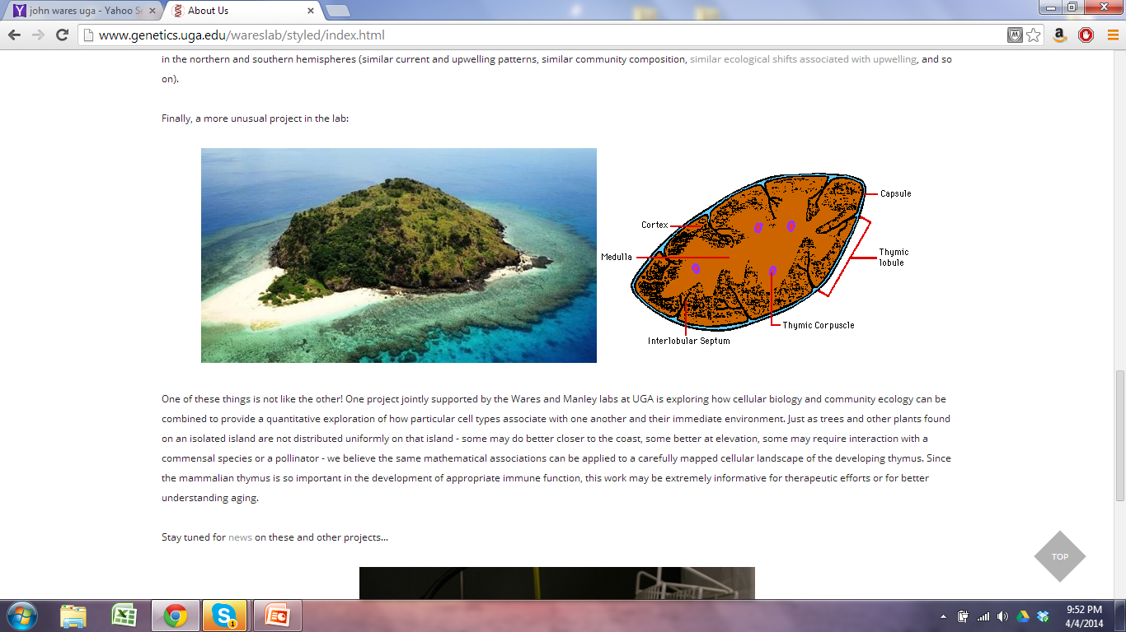
How can we look at the location and abundance of cell types in organs?
Notes:
John wares-came up with idea to treat organ like an ecosystem, can apply quantitative ecological approaches directly to a biological organ
For this project, we used the thymus for our analysis
for example: compare thymus to island (pic), both have different regions (island has sandy area where land that meets water, area dense with with trees, etc. different compositions of species in these areas. Similar to thymus that is composed of different regions that has different compositions and abundances of cell types, like that of species on an island
By making this comparison and treating thymus like an ecosystem, we can apply quantitative approaches to thymus
Thymus is great organ for this type of analysis/comparison. was chosen because because of structure and size.
Proper Cell organization is very impt for function.
Have cellular markers and markers for different t-cell differentiation stages.
Markers cover a good portion of the thymus so that we are able to create a thymic map of the cell types.
Through qualitative analysis (using cell specific markers), we know general patterns of regional organization
We don’t even know specifics about cellular organization.
Look at states of disequilibrium-compare WT and mutant
How effective are clinical interventions
Mutants, Involution,Diseased stated

Slide 4
Questions of Interest
Are cells organized a certain way? Is this pattern consistent throughout the organ? Throughout Individuals? Random?
Do certain cell types tend to aggregate together?
Is there a certain abundance of cell types necessary for optimal organ function?
Do any cell types act as “keystone species”?
Notes:
removal completely changes cellular organization of organ
Impt but Maybe don’t see any organizational differences
Different levels of organization we currently can’t see with the naked eye?

Slide 5
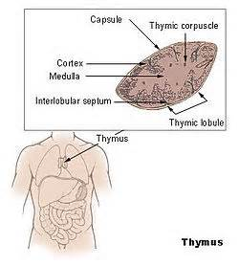

Background
Why is the thymus important?
Essential for proper immune system function
Programs T cells
Loss of functional thymic activity = reduced T cell output
Susceptibility to diseases
Autoimmunity
Notes:
Takes immature t cells and turns them into functional mature t cells (involved in immune response)
-involved in immune response
Lack of T cells-diseases
Autoimmunity-t cells that don’t function properly aren’t removed

Slide 6
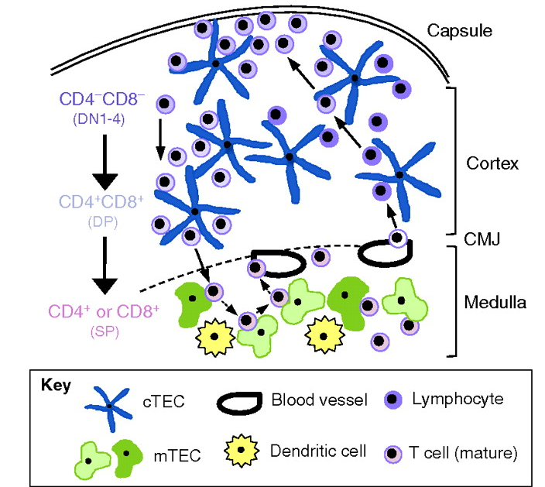
Thymus Cell Types and Migratory Pathway of T cells (Adult WT Thymus)
Notes:
Picture is showing section of thymus from the capsule downward to medulla
Several different regions
Cortex: Outer region
Medulla: Inner region
Cortocomedullary Junction (CMJ): Area where they meet
Subcapsular region: Outer cortex
Mesenchymal capsule that surrounds the thymus
Showing cell types of thymus that I’m including in my analysis; there are other cell types though
Resident cell types:-make up the organ
Thymic epithelial cells (TECs)-support mTECs (medullary thymic epithelial cells)-cTEC (cortical thymic epithelial cells)
Vasculature-blood vessels
Dendritic cells-involved in maturation of t cells
Migrating cell types:
Different things happening in cortex and medulla: regions have specific functions
Cortex: T lineage commitment, early tcell expansion and differentiation, positive selection
Medulla: final stages of tcell maturation and proper induction of central tolerance
Also undergoing positive and negative selection as they are differentiating
Cortex:
Different things happening in different regions
Thymocytes undergo positive selection to determine if they are functional, can detect peptide antigens-Self restricted
Medulla:
They undergo negative selection to remove overly sensitive, autoreactive thymocytes-self tolerant
Enter bloodstream to be taken out of thymus
At this point, they are naive, immunocompetent

Slide 7
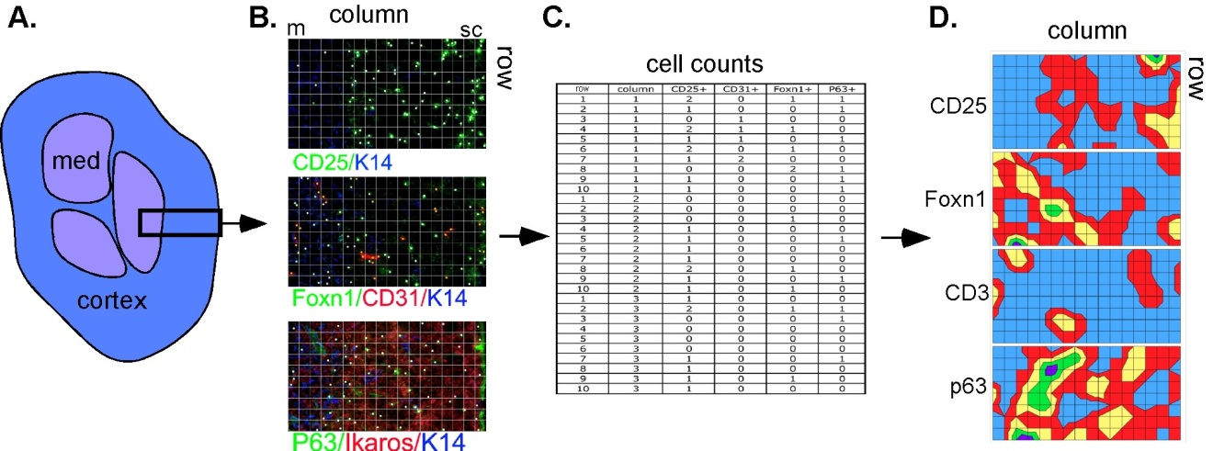
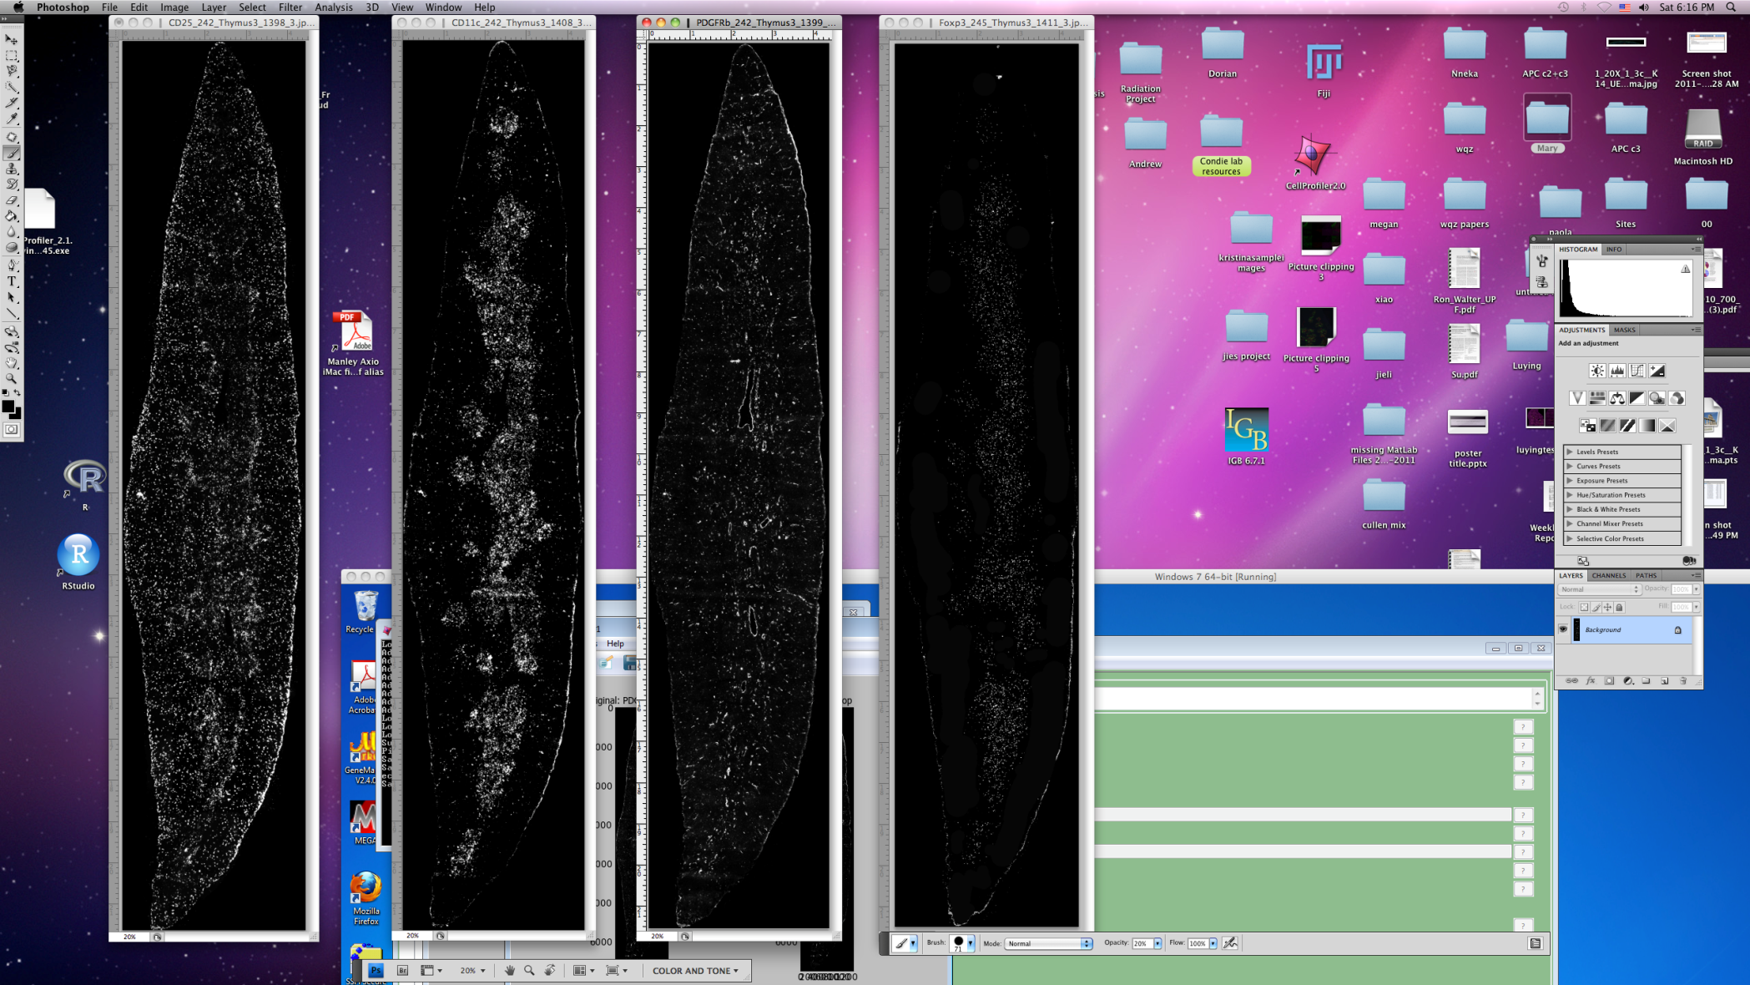
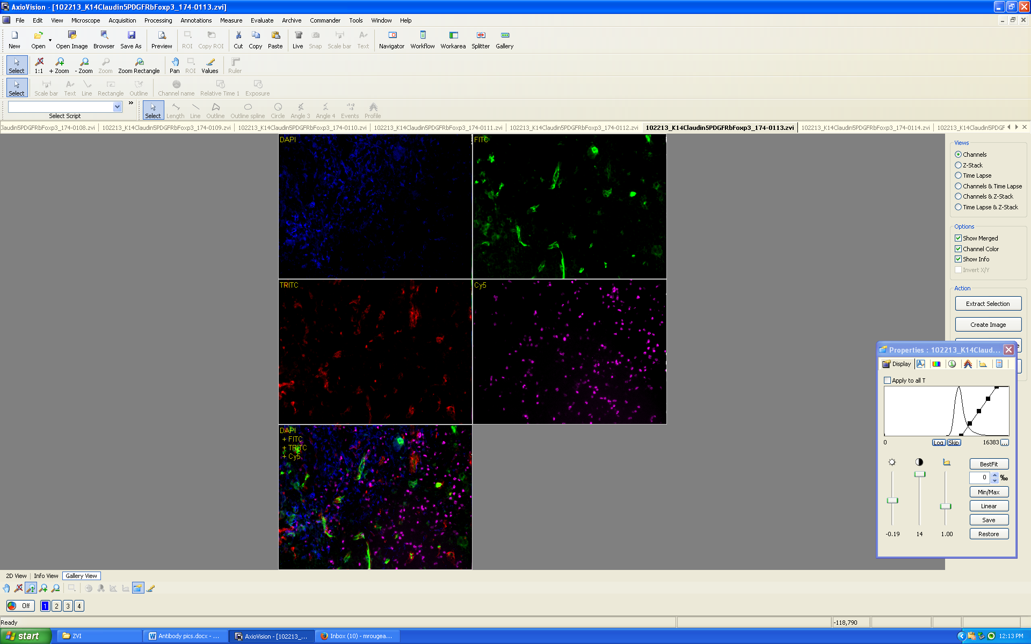
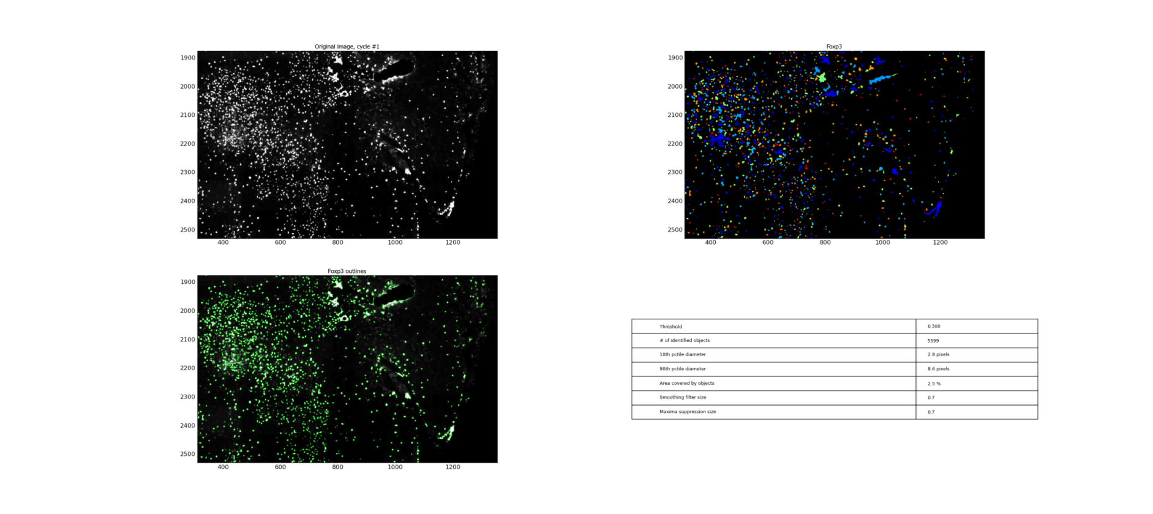

Overview of Methods-Identifying and analyzing cell types
Step 1 Step 2 Step 3 Step 4
Cut sections and
stain with antibodies
Take pictures
with microscope
Recreate section and
perform cell counts in CellProfiler
Perform spatial
analysis
Notes:
Goal: Develop a method that would allow us to identify the location of a variety of cell types that we can use for our statistical analysis
HARD TO DO!! (look at lots of different cell types); no one else has done this before!
Take middle sagittal sections of 1 month old wild type thymus and stain them with antibodies that bind to specific cell types
Take pictures with microscope along the entire thymus section
Piece them together using PTGui and use Cell Profiler (cell counting program) to perform cell counts on sections
Use cell location and abundance info from these sections for spatial analysis, this image is showing a heat map of different cell markers
1st step = stain sections with antibodies that mark specific cell types and use microscope to take pictures across the entire section
11 cell types
Example of 4 cell types on microscope
We wanted as much statistical power as possible, so tried to include as many cell types as possible. Limited by # of channels on microscope and antibodies specificity (cross reaction)
Blood vessels,
mTEC and cTEC
Subsets of T cells
Dendritic cells
Piece the images produced from the microscope together using PTGui (panormaic picture stitching software)

Slide 8
Goal: Develop a quantitative model to characterize the spatial organization of cell types in a steady-state postnatal mouse thymus using cell location and abundance
Spatial clustering by cell type
Use an ecological index on different regions that are produced
Look at spatial relationships between cells
Repeat with mutant
Notes:
Using cell
Spatial clustering by cell location and abundance
K means clustering

Slide 9
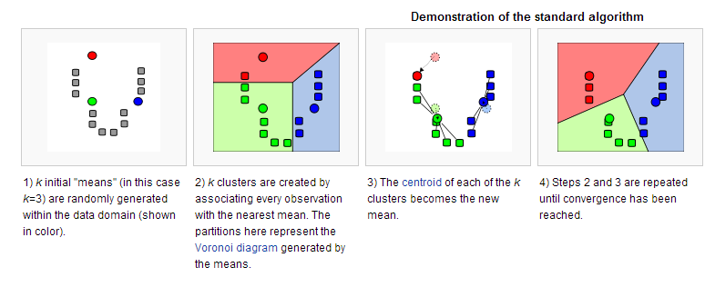
K means Clustering
Notes:
K-means clustering is a data mining technique that uses an algorithm to cluster observations with observations they are most similar to
The algorithm clusters observations into k groups, where k is provided as an input parameter.
WE CHOSE TO USE K MEANS AS OPPOSED TO OTHER CLUSTERING METHODS BECAUSE:
CAN CHOOSE DIFFERENT CLUSTER VALUES

Slide 10
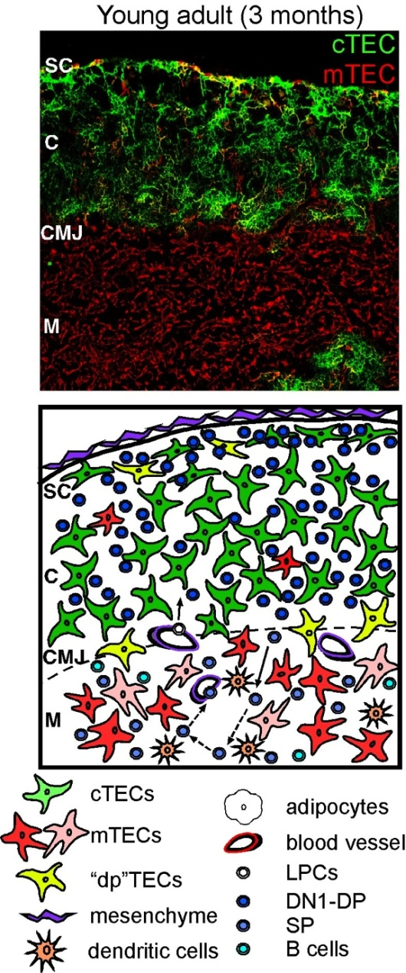
K means clustering-R-Why K=4 BC
Regions
Cortex, Medulla, Subcapsular region, CMJ
Can these regions be computationally reproduced?
Do we identify cryptic information (other regions or subsets)?
Is pattern consistent throughout thymus? Between samples?
Notes:
Currently, descriptive methods used to describe the regions.
Will allow us to test the structure of the thymus in a statistical framework (as opposed to descriptive)
If we manipulate K value
Help provide support for the number of compositionally distinct thymic regions, or could produce regions we don’t know about
identify geographical clusters of cell types based on compositional similarities, position, and abundance. We then used a range of K values to identify potentially cryptic organization.
Our goal is not only to identify whether groups of 2 or more cell types have similar relative distributions (between regions or within the same regions), but also to quantify the extent to which mutants or diseased thymuses are significantly less structured than wild-type. This clustering algorithm generates a posterior probability that any subsample (quadrat) belongs to each of the k different groups, while maximizing the ratio of compositional differences between groups to compositional variation within groups. The k groups produced are presumably functionally distinct, and a key hypothesis we will test is whether Kmutant is significantly less than kwildtype for each comparison.

Slide 11
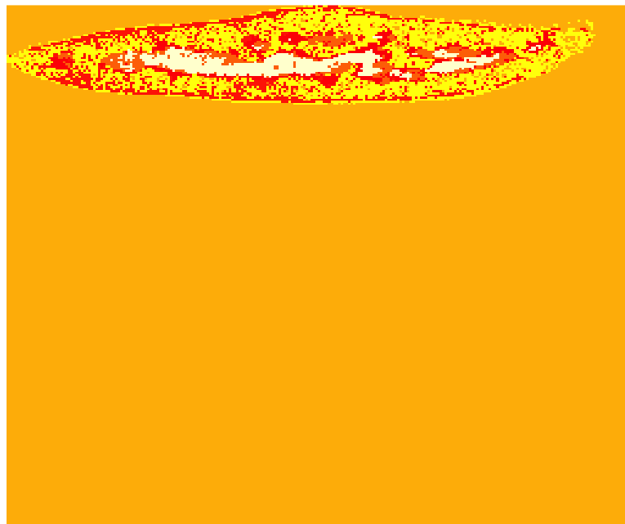
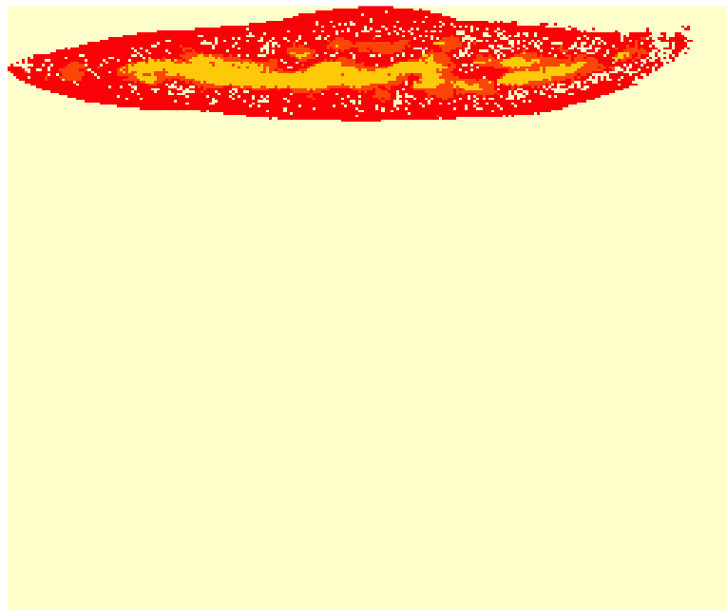
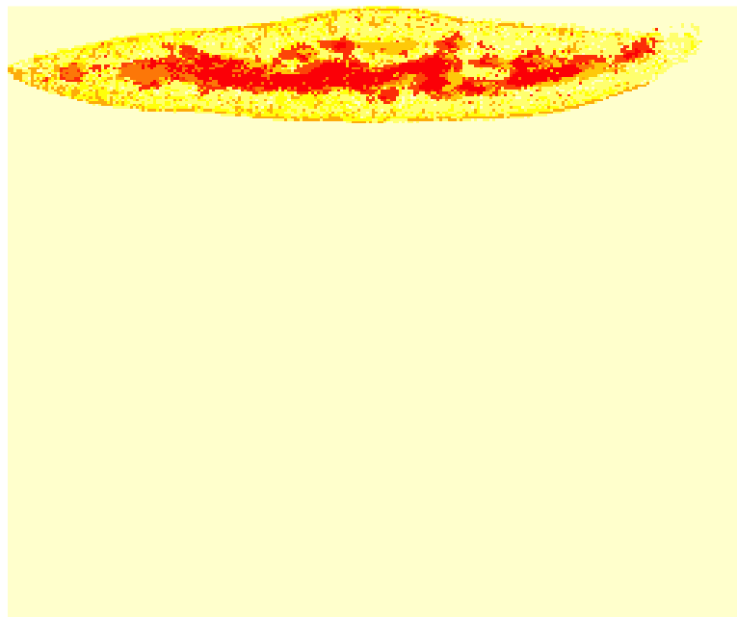
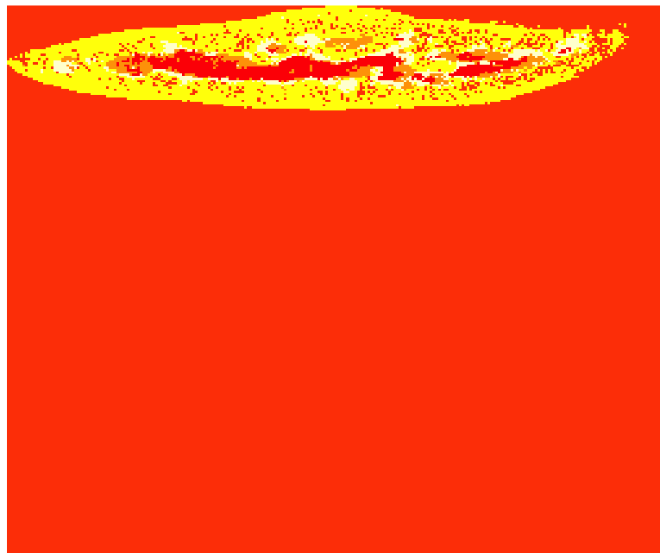
Results-Different Number of Clusters (/250)
K = 3 K=4 K=5 K=6 K=10
Notes:
different colors; k = 3 means I want 3 different clusters ( I set)
K=3 shows 3 main regions
K=4 Subdivided medulla more instead of subcapsular/capsule cluster-AREA NO ONE HAS SEEN BEFORE!!
As cluster size increases, smaller clusters in cortex and medulla begin to appear
Next job: figure out if this is an interesting result, does it have a biological meaning anything? Or is it an artifact of K clustering?
Show results from looking at these regions, is what im doing make sense? Am I analyzing this correctly?

Slide 12
How is clustering being done?

Slide 13
Goal: Develop a quantitative model to characterize the spatial organization of cell types in a steady-state postnatal mouse thymus.
Spatial clustering by cell type
Use an ecological index on different regions that are produced
Look at spatial relationships between cells
Repeat with mutant

Slide 14
Bray Curtis Dissimilarity Index
Notes:
Why do we want to use ecological index? To find K value. Also, can use to determine how similar other sections are to each other and to compare with mutant.
Statistical method used in ecology, want to quantitatively describe results; move away from purely descriptive approaches
In ecology, the identity and relative abundance of species can be compared across communities using various dissimilarity indicies
The Bray Curtis Dissimilarity Index in particular is a well characterized statistical method used to quantify the compositional dissimilarity between two sites, based on counts at each site. Value between 0 and 1, 0=don’t share any species, 1=identical
We applied Bray Curtis to our samples to determine the degree of dissimilarity between clusters produced from K means clustering based on cell count. Bray Curtis was also used to make comparisons between different thymic samples and subsamples, and the amount of distinctiveness can also be compared to ecosystems/natural systems/ecological communities and subregions.
Is value consistent between other sections? Samples? What about with mutants?

Slide 15
Goal: Develop a quantitative model to characterize the spatial organization of cell types in a steady-state postnatal mouse thymus.
Spatial clustering by cell type
Use an ecological index on different regions that are produced
Look at spatial relationships between cells
Repeat with mutant

Slide 16
Mutant-Aire knockout
Aire = TF expressed in subset of mTECs
Removal of Aire causes defective negative selection and multi-organ autoimmunity
Defects in organization or composition?
Phenotype: Viable, normal in size, and at birth don’t display physical/behavorial abnormalities. Females infertile. mTEC number is doubled. Possible displaced dendritic cells
Anderson MS et al. 2002. Projection of an immunological self shadow within the thymus by the aire protein. Science 298(5597):1395-401-Dendritic phenotype similar between WT and Mutant
Notes:
Negative selection-removal of tcells that recognize self antigens and attack the body
Model as Regulator of tissue restricted antigens or as key modulator of mTEC differentiation
-Relative species abundnance may not be affect or may change dramatically
-Look at UEA1
Central tolerance
http://jaxmice.jax.org/strain/004743.html
Similarly, a near doubling in the numbers of activated/memory CD44^{hi}CD62L^{lo} T lymphocytes is observed. A loss or reduction in expression occurs for a substantial number of genes in MECs, an observation consistent with the targeted gene's role as a transcriptional activator.

Slide 17
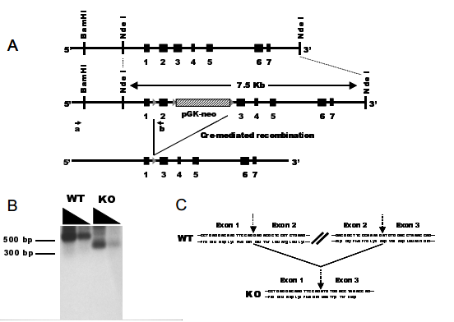
Aire Mutant
How knockout is produced?
Anderson et al,
Notes:
Development To create this mutant, the originating investigator employed a targeting vector bearing a loxP site-flanked Pgk-neo cassette inserted into intron 2. An additional single loxP site was placed in intron 1. The targeting construct was electroporated into 129S2/SvPas-derived D3 embryonic stem (ES) cells. Correctly targeted ES cells were injected into C57BL/6 blastocysts. The resulting chimeric mice were mated with CMV-cre transgenic mice on a C57BL/6 background. Exon 2 and portions of introns 1 and 3 were excised in the offspring. The resulting chimeric animals were crossed to C57BL/6 mice. Heterozygous offspring were crossed to
We engineered a line of mice carrying a defective aire gene by means of lox/cre-mediated recombination in embryonic stem (ES) cells (fig. S1). These mice carry in homozygous state a mutant allele bearing a deletion of exon 2 and portions of the upstream and downstream introns (fig. S1A). Mature aire gene transcripts could be detected at nearnormal levels in the thymus of mutant mice, but these were smaller than in the wild type, as expected given the absence of exon 2 (fig. S1B). Sequence analysis confirmed that these transcripts could not give rise to functional protein because a frame shift provoked by the abnormal juxtaposition of exons 1 and 3 resulted in premature truncation shortly after exon 1 (fig. S1C). The aire gene mutation was generated in ES cells derived from mice of the Sv/129 strain, and mice used in the experiments described here were from F[sub2] or F[sub3] backcrosses onto the B6 genetic background.

Slide 18
RESULTS
K means clustering. Bray curtis.

Slide 19
Goal: Develop a quantitative model to characterize the spatial organization of cell types in a steady-state postnatal mouse thymus.
Spatial clustering by cell type
Use an ecological index on different regions that are produced
Look at spatial relationships between cells
Repeat with mutant

Slide 20
Conclusions and Future Directions
We are not seeing the 4 regions we expected to see
Subdivision of the medulla
Further spatial analysis
Understand how regions are being clustered
Dissimilarity index
Density and co-distribution of cell types
Test model using a mutant that has been characterized
Notes:
Interesting biologically-assumed tcells move through medulla, give more info on how tcells move through thymus
1) Removing cell type that seems to be important in clustering and seeing if clustering shifts
2) Ecological index-get an idea of how different cellular compositions are between different regions produced from k-means
Are the values similar between replicates?
Find an example in the literature to compare it – Bray Curtis
Varies between 0 and 1
0 = sites are identical (same species composition)
1 = sites don’t share any species
3) Look at spatial relationships of cells-cell to cell interactionss; are there patterns that we can see with our eyes?
do some cell types aggregate together more than others?
is there a certain distribution and abuncance necessary for proper functioning of the thymus? (percolation theory, ripleys k)
Will the removal of a cell type completely change the celular composition?
Test my model, Repeat everything I’ve done now with Aire mutants, known patterning difference bt wt and ko; test model to see if it works; test how robust it is, mutant that has been characterized, mutant phenotypes are known

Slide 21
Acknowledgements
Committee
John Wares
Nancy Manley
Andrew Park
Brian Condie
Manley Lab Wares Lab
Notes:
INCLUDE RAREFACTION CURVE

Slide 22
Virtual Sections
Antibody Set 1
Antibody Set 2
Antibody Set 3
Virtual section
Collapse 3 virtual sections= virtual slice

Slide 23
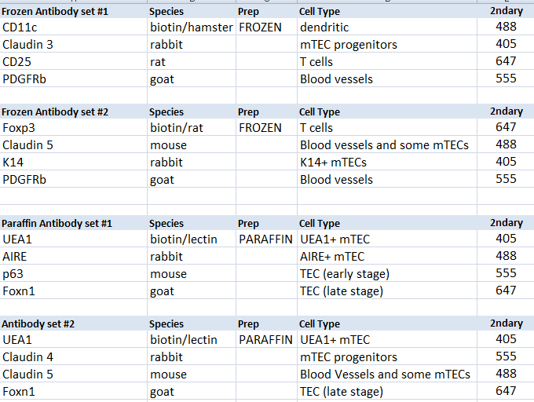
Combinations of Antibodies Finalized List-Frozen and Paraffin 7 cell types
Notes:
Cross reaction if 2 of same species in same set
CD11c-dendritic cells (antigen presenting) and some activated t cells, Central tolerance of T cells, b cells and NK cells (apoptosis of self reactive t cells), cellular adhesion
Claudin3&4- membrane protein, tight junction family, cell to cell adhesion in epithelial/endothelial sheets, for seals around cells, physical barrier to solutes and water, PREFERENTIALLY EXPRESSED IN aire+ mTECS, CLDN3,4, UEA1 tecs represent initial progenitors specified for Aire+ mTECS
CD25-glycoprotein, expressed on activated T and B cells, thymocyte subsets, pre-b cells, and t reg cells, IL2 receptor, transmembran protein present on activated T cells, DN2 and DN3 are CD25+ ; DN1-DN4 – CD4 CD8 SP
PDGFRb-Perivascular cells express mesenchymal markers, so does capsule
Gene encodes a cell surface tyrosine kinase receptor, binding causes phosphorylation (may control growth, division, movement, survival, development)
Foxp3-forkhead box p3, transcriptional regulator, high expression in CD4CD25 reg t cells, suppress immune response of other cells “self check” to prevent excessive reactions and prevent self reactivity, occurs in medulla, some t cells become Treg and rest leave thymus
Claudin5-cell surface/transmembrane marker, claudin family, tight junction strands of endothelia and epithelia tissues
K14-keratin, cytoplasmic intermediate filament protein, expressed in epithelial tissues, provide mechanical support, maintain cell shape
UEA1-lectin (binds carbohydrate), endothelial cell marker, binds K8 and not K14,K5, AIRE more preferentially expressed in this subset, suggests these cells represent more advanced stage of mTEC differentiation
AIRE-autoimmune regulator, transcription factory that is highly expressed in perinuclear region of mature medullary thymic epithelial cells, central tolerance, controls transcription of many genes encoding highly diverse, tissue-restricted self antigens, in absence of AIRE, mTECS fail to delete thymocytes expressing Tcell “self” receptors
P63-related to tumor suppressor gene family, early epithelial cell marker, induces expression of differential markers and shortly after its own levels are reduced, may stimulate cell survival
Foxn1-member of forkhead transcription factor family, generates mature thymic epithelial cells from immature progenitory, requires through development to maturity, “master regulatory” in TEC lineage specification, tec patterning in fetal stage and tec homeostasis in postnatal thymus

Slide 24
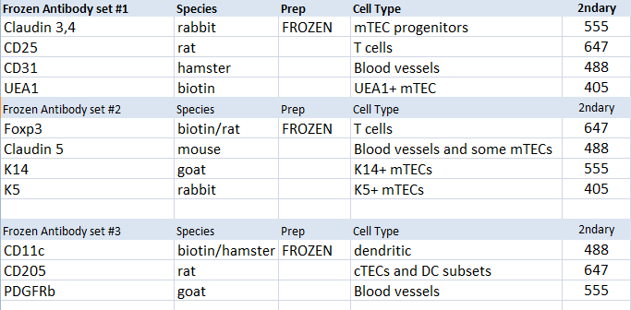
Combinations of Antibodies Finalized List-Frozen 11 cell types

Slide 25
Size conversion (from pixels to mm)
Original pixel size/4 = ~1500 pixels width
6695 pixels =8.5mm
788 pixels/mm
6462 pixels = 8mm
810pixels/mm
5635=7mm
805 pixels/mm
Notes:
CellProfiler uses pixel information, outputs info in pixels
Pixels not biologically meaningful, change to mm (1000 microns) or microns

Slide 26
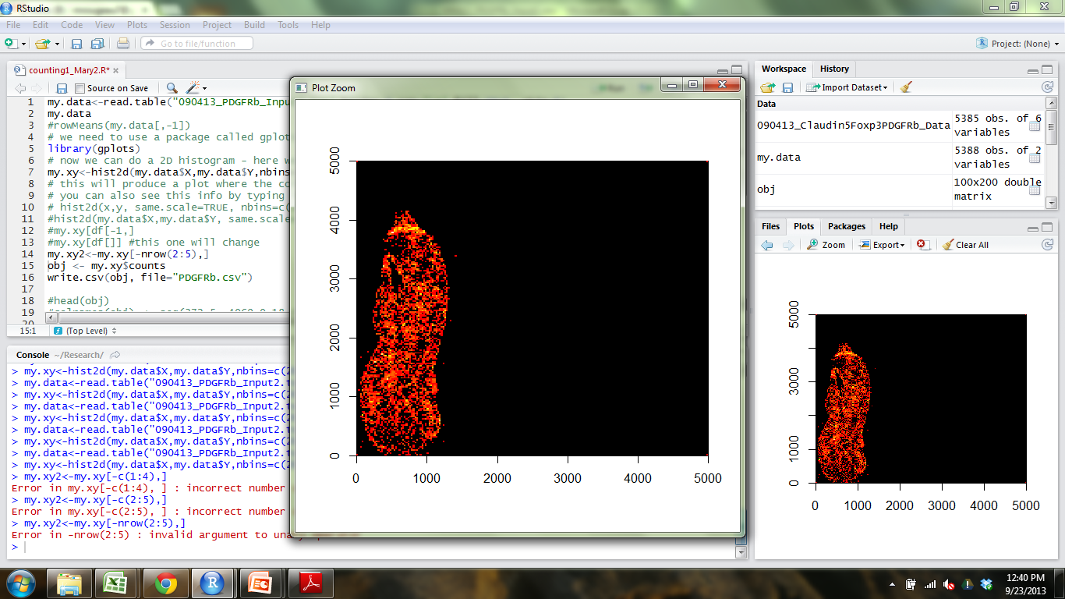
R
Notes:
CellProfiler outputs X and Y coordinates of cells
2dHistogram function to bin coordinates into quadrants of size that I choose-200x200 boxes, 100x100-
want to look like community matrix, with bins that has count info
Since I am looking at multiple sections, I want bin sizes to be the same between sections
I add 4 points (0 and point larger than section height)-6000 for thymus1
(0,0) ,(0,6000),(6000,0),(6000,6000) (I wanted them to be square)
2dhisto-Matrix (grid) is built that holds the counts that fall into each bin/quadrant of grid
Use the counts in the quadrants for analysis

Slide 27
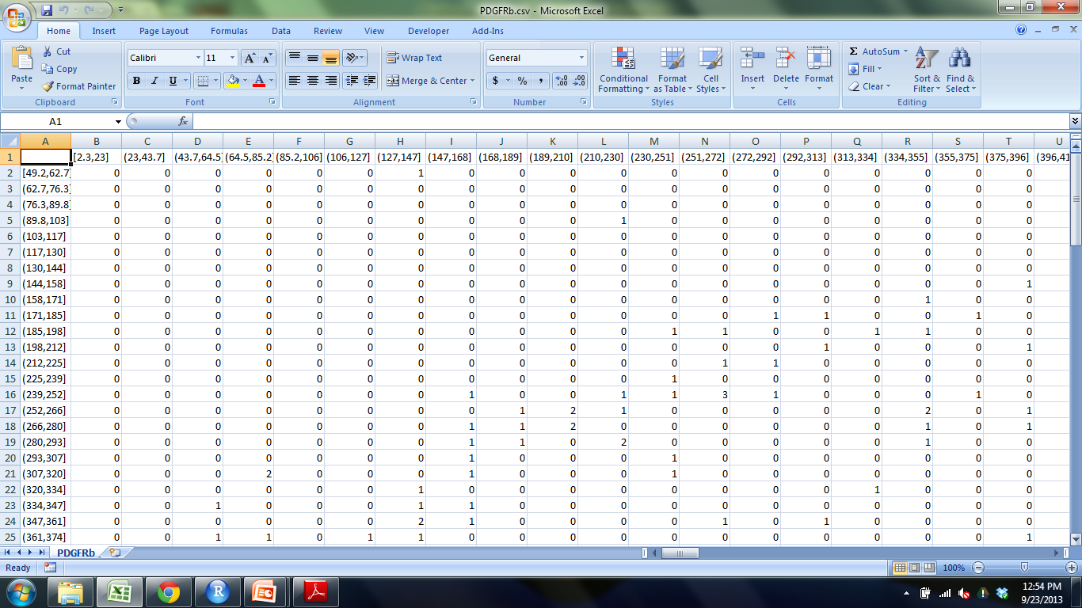
Output from 2D histogram
Notes:
Cell counts in each bin/quadrant
Bin sizes are in pixels, convert to mm or microns

Slide 28
Standard Real Measurement of bin sizes
5635 = 7 mm
5635/7 = 6000/x x=height of 6000x6000 box in mm
X= 7.453 mm
Assuming 200x200 bins
7.453/200 = 0.037265mm = 37.2 x 37.2 microns

Slide 29
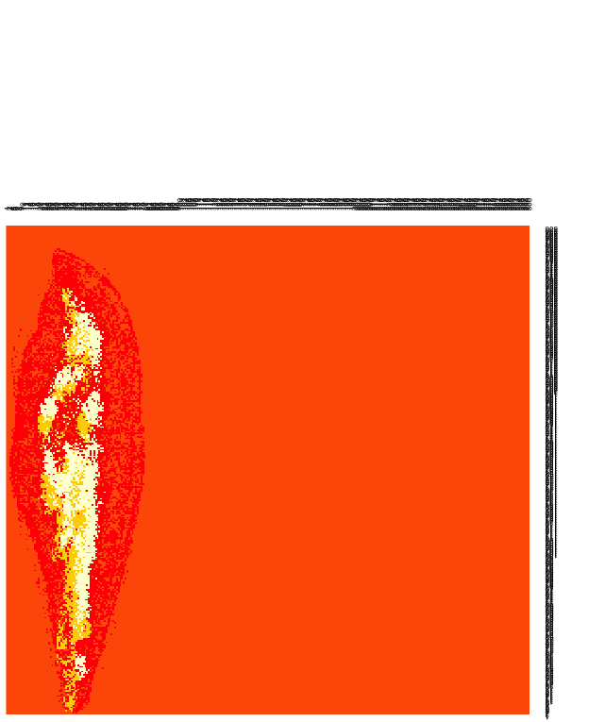
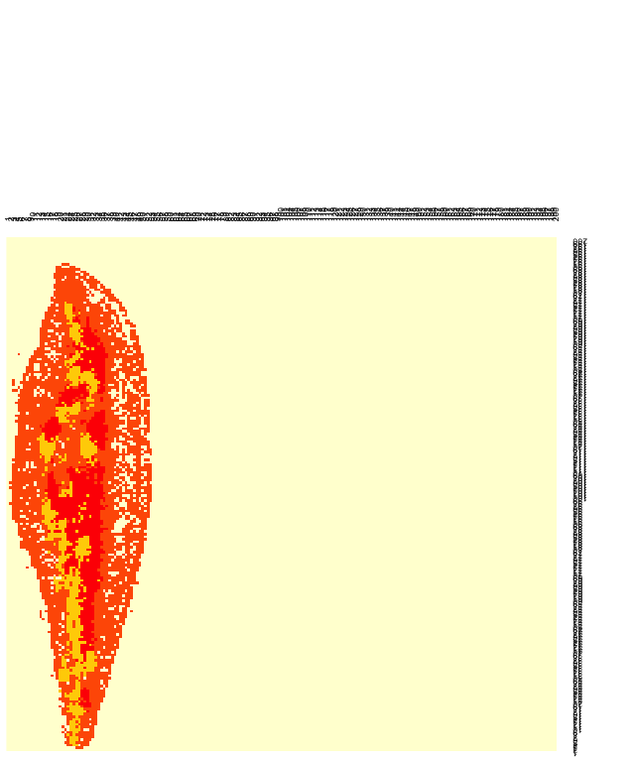
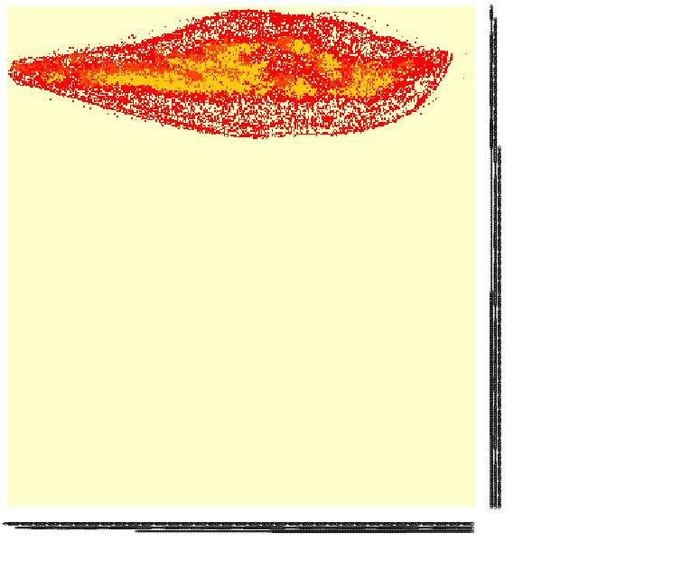
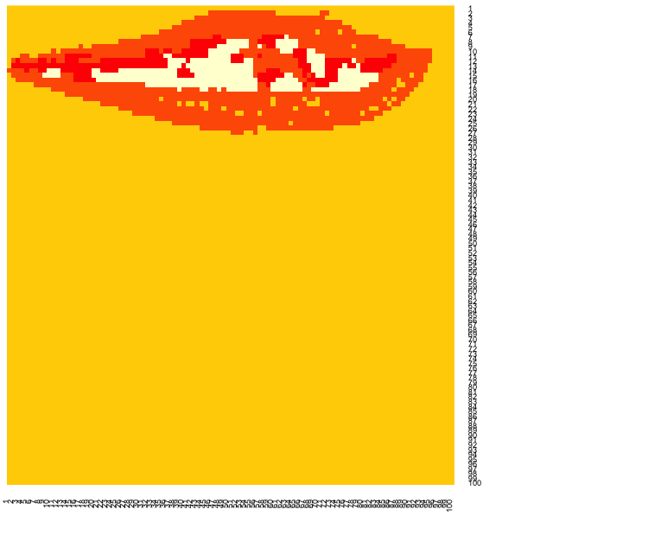
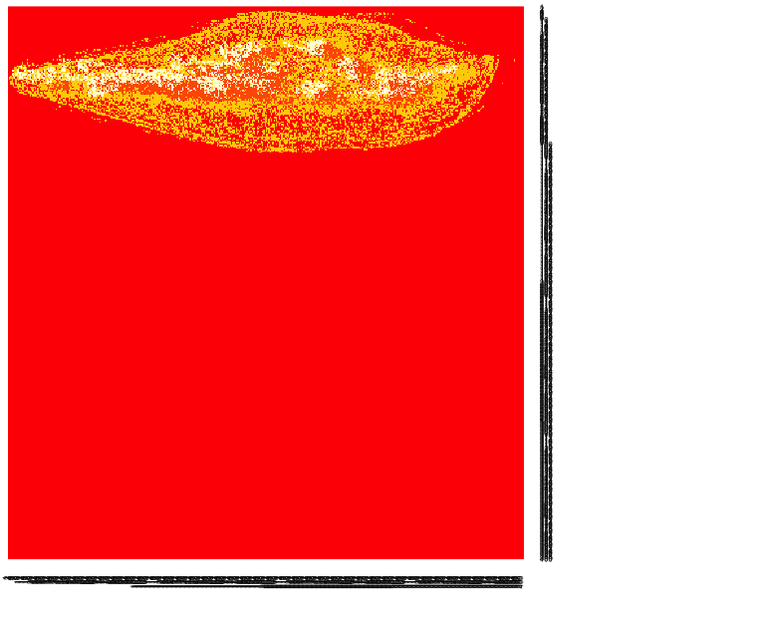
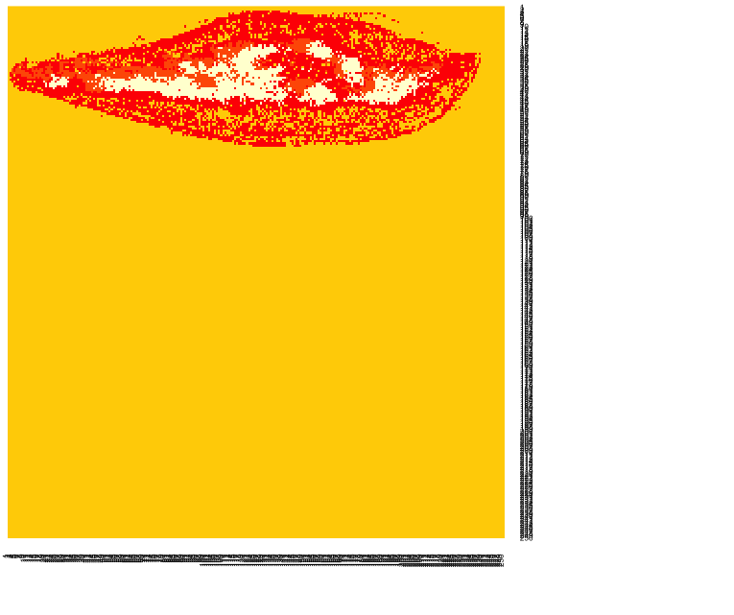
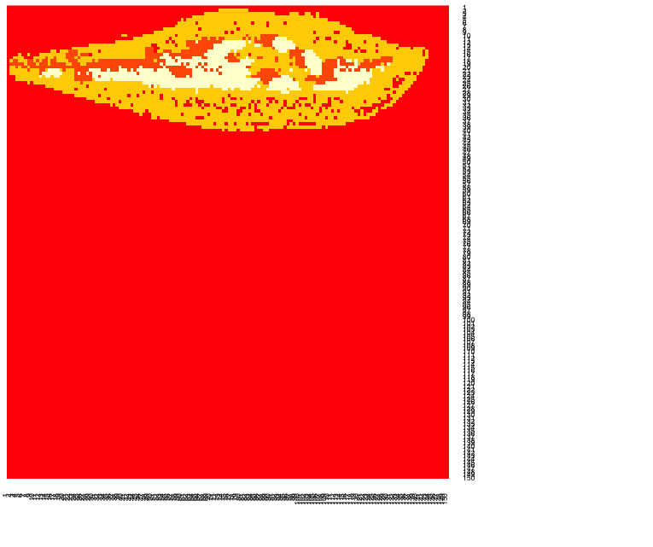
Different bin sizes (K=4)
400x400 350x350 300x300 250x250 200x200 150x150 100x100
Which bin size is optimal?
Notes:
First time I did analysis, I Randomly picked 200x200, cell counts in each bin were reasonable number (not too high or low)
Not good reason, Need something to support this number

Slide 30
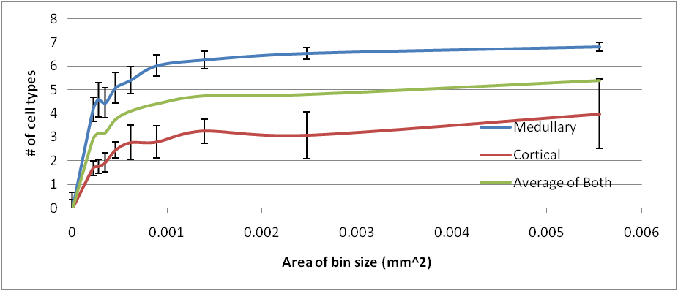
Rarefaction Curve
Area (mm2) | BINS
0.00022 | 500x500
0.00027 | 450x450
0.00035 | 400x400
0.00045 | 350x350
0.00062 | 300x300
0.00089 | 250x250
0.00139 | 200x200
0.00247 | 150x150
0.00555 | 100x100
0.0222 | 50x50
Notes:
Determining the optimal quadrant size: Rarefaction
Rarefaction-technique used in ecology to assess species richness (# of species) from the results of sampling.
The issue that occurs when sampling species in a community is that the larger the number of samples, the more species that will be found.
When have you collected enough samples? (when is the bin size small/large enough) large bin size=more samples, get to point where you will lose info
Want to find the smallest unit of area that still contains useful information, construction of rarefaction curves,
Selected 5x5 quadrants and took average over a section of thymus that contained #of cell types (as opposed to # of cells). I did this 8 times in cortex and 8 times in medulla (since medulla had higher cell counts than cortex) and took average of that
Steep slope indicates that a large fraction of the species diversity (cell types) remains to be discovered.
When the curve becomes flatter to the right, a reasonable number of individual samples have been taken: more sampling is likely to yield only few additional species.
Saturated for medullary region when curve plateaus, probably won’t have all 7 cell types in the cortex (medullary markers)

Slide 31

Community Matrix
Notes:
Take the count information from 2Dhistogram and Reformat into community matrix with some species (columns) and where they are located (rows).
Initially had location information (way of identifying bin locations) but this info took over the clustering
This is the format I will use for my analysis (kmeans)

Slide 32
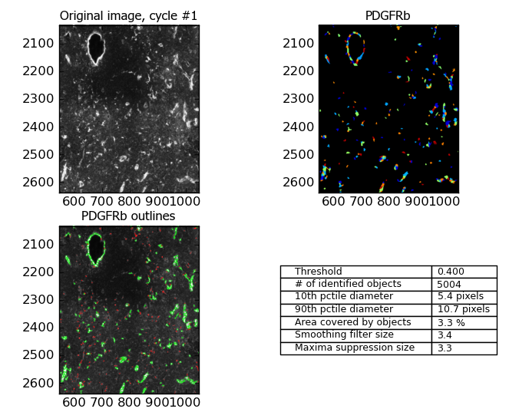
CellProfiler Results-Blood vessel marker
CD25
Notes:
Input images from Ptgui into Cellprofiler to get cell counts which will be used for analysis
Real signal, Intensity of fluorescence
Different colors = different cells,
Finds centroid of cell and outputs x and y location
This shows a zoomed in portion of the thymus so you can see what CP considers to be a cell
Green is what CP detects bc of parameters I set, centroid!
Take cellprofiler results, reformat, use them in R
Place grid over thymus section and record # of cell for each cell type that fall into each box of the grid

